Slide 1
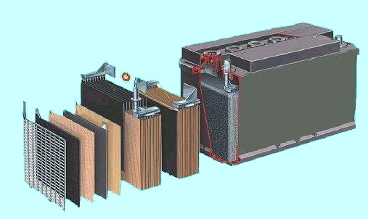
BATTERIES AND BATTERY CHARGING

Slide 2
  2 CLASSES OF BATTERIES
  PRIMARY CELLS
  SECONDARY CELLS

Slide 3
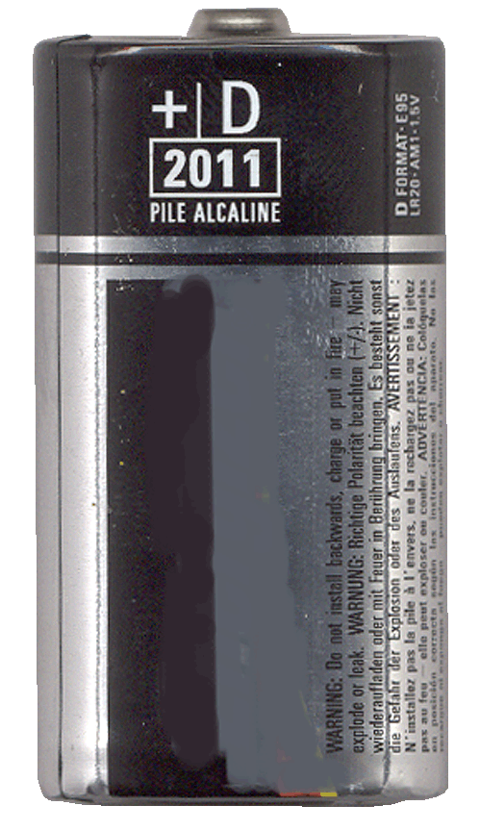
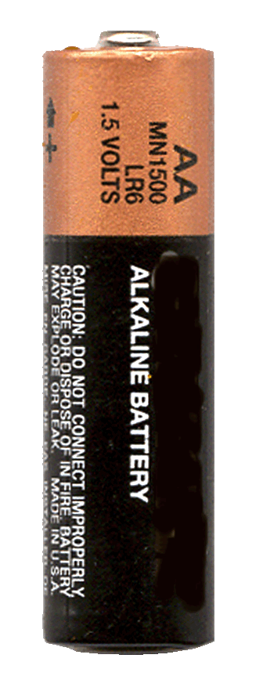
PRIMARY CELLS
CANNOT BE RECHARGED
CHEMICAL PROCESS NOT REVERSABLE
ZINC CARBON (1.5V)
ALKALINE (1.5V)

Slide 4
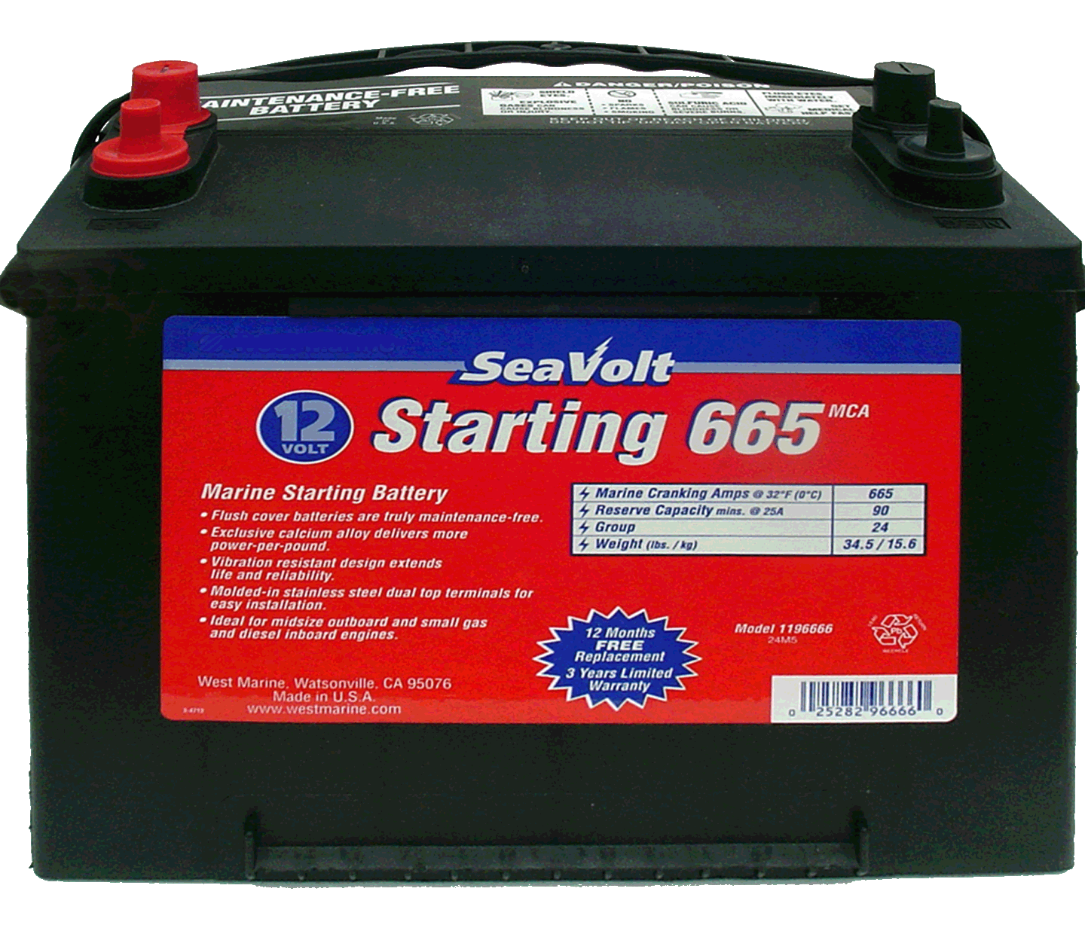
SECONDARY CELLS
CAN BE RECHARGED
CHEMICAL REACTION REVERSABLE
LEAD ACID (2.0V)
NICKEL - CADMIUM (1.2V)
NICKEL - METAL HYDRIDE (1.2V)
LITHIUM – ION (3.3V)

Slide 5
COMPOSITION OF A BATTERY
The Lead Acid battery is made up of seperator plates, lead plates, and lead oxide plates (various other elements are used to change density, hardness, porosity, etc.) with a 35% sulphuric acid and 65% water solution. This solution is called electrolyte which causes a chemical reaction that produce electrons.
When a battery discharges the electrolyte dilutes and the sulphur deposits on the lead plates.
When the battery is recharged the process reverses and the sulphur dissolves into the electrolyte.

Slide 6
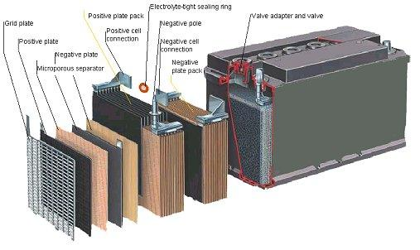
BATTERY CROSS SECTION

Slide 7
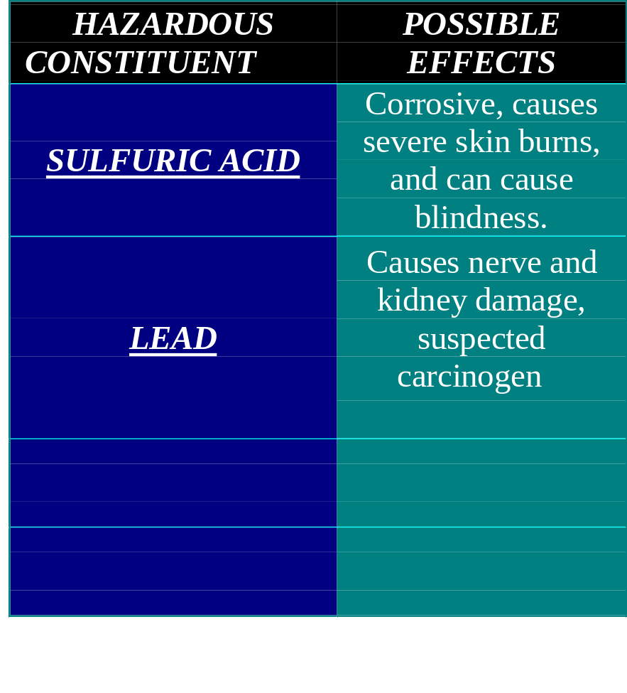
Battery
Notes:
-REFER TO MSDS SHEETS FOR SULFURIC ACID / LEAD
SULFURIC ACID -- CORROSIVE, CAUSES SEVERE SKIN BURNS, AND CAN CAUSE BLINDNESS.
LEAD -- CAUSES NERVE AND KIDNEY DAMAGE, SUSPECTED CARCINOGEN

Slide 8
Specific Gravity
Ratio of the weight of a given volume of a substance to the weight of an equal volume of some reference substance, or, equivalently, the ratio of the masses of equal volumes of the two substances.
Example: It is the weight of the sulfuric acid - water mixture compared to an equal volume of water. Pure water has a specific gravity of 1,000.
Notes:
THE MOST WIDELY USED REFERENCE SUBSTANCE FOR DETERMINING THE SPECIFIC GRAVITY’S OF SOLIDS AND LIQUIDS IS WATER.
BECAUSE THE DENSITY OF WATER IS VERY NEARLY 1g/cm³, THE DENSITY OF ANY SUBSTANCE IN g/cm³ IS NEARLY THE SAME NUMERICALLY AS ITS SPECIFIC GRAVITY RELATIVE TO WATER.
IN THE ENGLISH SYSTEM OF UNITS THE DENSITY OF WATER IS ABOUT 62.4 lb/ft³, SO THE NEAR EQUALITY BETWEEN SPECIFIC GRAVITYAND DENSITY IS NOT PRESERVED IN THIS SYSTEM.
SPECIFIC GRAVITY’S OF GASES ARE OFTEN GIVEN WITH DRY AIR AS THE THE REFERENCE SUBSTANCE.
BECAUSE OF THE DENSITIES OF ALL SUBSTANCES VARY WITH TEMPERATURE AND PRESSURE, THE TEMPERATURE AND (PARTICULARLY FOR GASSES) THE PRESSURE FOR BOTH THE REFERENCE SUBSTANCE AND THE SUBSTANCE OF INTEREST ARE OFTEN INCLUDED WHEN PRECISE VALUES OF SPECIFIC GRAVITY’S ARE GIVEN.

Slide 9

Hydrometer
Device used to determine directly the specific gravity of a liquid.
Notes:
GIVES THE SPECIFIC GRAVITY READING DIRECTLY.
IT USUALLY CONSISTS OF A THIN GLASS TUBE CLOSED AT BOTH ENDS, WITH ONE END ENLARGED INTO A BULB THAT CONTAINS FINE LEAD SHOT OR MERCURY TO CAUSE THE INSTRUMENT TO FLOAT UPRIGHT IN A LIQUID.

Slide 10
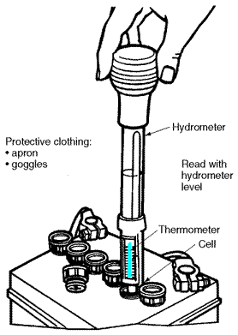
Hydrometer
The chart below gives state of charge vs. specific gravity of the electrolyte.
State of Charge Specific Gravity
100% Charged 1.265
75% Charged 1.239
50% Charged 1.200
25% Charged 1.170
Fully Discharged 1.110
These readings are correct at 75°F
Notes:
THE QUICKEST WAY TO RUIN LEAD ACID BATTERIES IS TO DISCHARGE THEM DEEPLY AND LEAVE THEM STAND DEAD FOR AN EXTENDED PERIOD OF TIME.
WHEN THEY DISCHARGE A CHEMICAL CHANGE IN THE POSITIVE PLATES OF THE BATTERY.
THEY CHANGE FROM LEAD OXIDE WHEN CHARGED TO LEAD SULFATE WHEN DISCHARGED.
IF THEY REMAIN IN THE LEAD SULFATE STATE FOR A FEW DAYS, SOME PART OF THE PLATE DOES NOT RETURN TO LEAD OXIDE WHEN THE BATTERY IS RECHARGED.
IF THE BATTERY REMAINS DISCHARGED LONGER, A GREATER AMOUNT OF THE POSITIVE PLATE WILL REMAIN LEAD SULFATE. THE PLATE BECOMES “SULFATED” AND NO LONGER STORES ENERGY
USE ONLY DISTILLED WATER.
TAP WATER MAY CONTAIN CHEMICALS OR OTHER IMPURITIES HARMFUL TO BATTERIES.
BATTERIES SHOULD BE FILLED ONLY AT THE END OF THE CHARGING CYCLE.

Slide 11
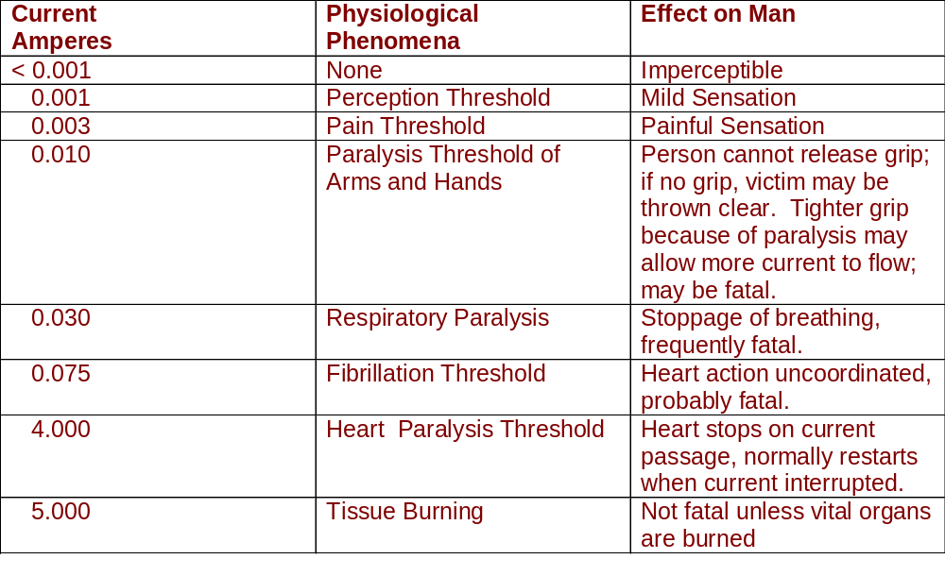
Currents
Notes:
LARGE CURRENTS MOVE IONS TO WHERE THEY SHOULD NOT BE, DISRUPTING BODILY PROCESSES.

Slide 12
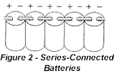
Series Connected Batteries
Positive terminal of one cell is connected to the negative terminal of the next, is called a series connected battery.
The voltage of this type of battery is the sum of a individual cell voltages.
Notes:
THE WAY BATTERIES ARE CONNECTED DETERMINES THE VOLTAGE AND CAPACITY OF THE BATTERY.

Slide 13
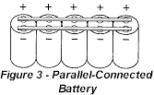
Parallel Connected Batteries
Connect the negative terminal from one cell to the negative of the next cell
Connect the positive terminal to the positive terminal, is parallel connected.
Voltage remains constant and the current is cumulative.

Slide 14
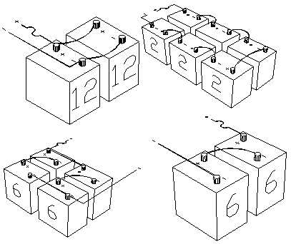
Series-Parallel Connections
SERIES
SERIES
PARALLEL
SERIES
SERIES-PARALLEL

Slide 15
TYPES OF RECHARGABLE LEAD ACID BATTERIES
DEEP CYCLE BATTERIES
FEWER THICKER PLATES
LOWER CURRENT DELIVERY OVER LONG PERIODS
CAN BE DISCHARGED BY 50% WITHOUT DAMAGE
CAN BE CYCLED MANY TIMES

Slide 16
TYPES OF RECHARGABLE LEAD ACID BATTERIES
DUAL PURPOSE BATTERIES
COMPROMISE BETWEEN MANY THIN PLATES AND FEWER THICK PLATES
CAN BE DISCHARGED BY 50%
FEWER CYCLES THAN DEEP CYCLE BATTERY

Slide 17
CHARGING
3 STAGES
BULK
ABSORPTION/ACCEPT
FLOAT

Slide 18
CHARGING
BULK STAGE
MAXIMUM VOLTAGE
MAXIMUM CURRENT

Slide 19
CHARGING
ABSORPTION
CONTROLED VOLTAGE
MAXIMUM CURRENT

Slide 20
CHARGING
FLOAT
CONTROLED VOLTAGE
CONTROLED CURRENT

Slide 21
CHARGING VOLTAGES
Flooded Gel AGM
Charging voltage @ 20º C
Bulk - 14.4 to 14.8 14.2 to 14.4 14.4 to 14.8
Acceptance - 14.2 to 14.4 14.00 to 14.2 14.2 to 14.4
Float - 13.2 to 13.6 13.5 to 13.8 13.2 to 13.5
Equalization - 15.0 to 16.0 Do NOT Equalize Do NOT Equalize

Slide 22
SULPHATION
Sulphation of Batteries starts when specific gravity falls below 1.225 or voltage measures less than 12.4 (12v Battery). Sulphation hardens the battery plates reducing and eventually destroying the ability of the battery to generate Volts and Amps. The battery develops a high electrical resistance.

Slide 23
WHAT NOT TO DO WITH BATTERIES
The following is detrimental to the life span of a battery:
Incorrect charge voltage.
Too low a voltage means that the battery does not charge to 100% - the sulphate then hardens on the plates and the battery loses some of it capacity. Excessive voltage causes the batteries to generate excessive gas leading to water los and drying out.
Excessive discharging.
Discharging a battery further than its capacity greatly shortens its life span
Too many cycles, high charge voltage, excessive discharging and significant voltage ripple in the charge voltage caused by cheap chargers and alternators.
Charging without 3 step regulation and very high electrolyte temperatures.

Slide 24
BATTERY TERMINOLOGY
VRLAB Flooded Valve Regulated Lead Acid Batteries
GEL Gelled Electrolyte Lead Acid Battery
AGM Advanced Glass Mat Battery
CCA Cold Cranking Amps -18°C terminal V ≥7.2V for 30 sec.
CA Cranking Amps 0°C terminal V ≥7.2V for 30 sec.
RC Reserve Capacity 25°C terminal V ≥ 10.5V 25A Load = time
AH 100Ah = 20 hrs @ 5A load terminal V ≥ 10.5V
Peukert Exponent (ⁿ) Charge factor indicating efficiency of a battery
Flooded cell battery is 80%. Must be recharged 1.2 times the capacity to reach 100%. Dynamic. Lower the factor – more efficient. Lithium-Ion 1.05.
Cp=Iⁿt Battery capacity = Discharge Current ⁿ x Time hrs

Slide 25
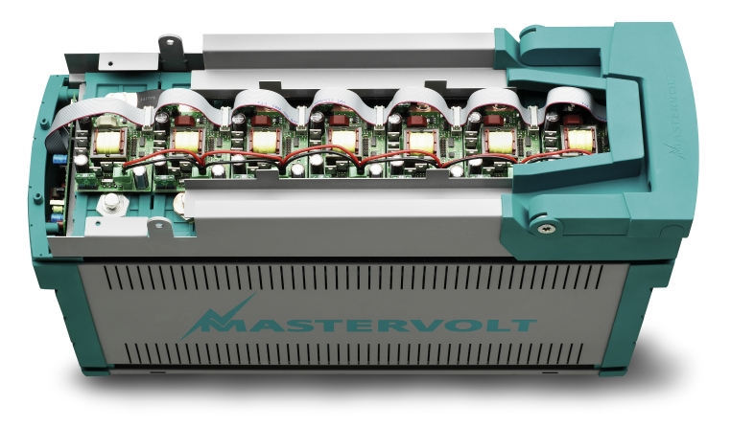
LITHIUM IRON PHOSPHATE
24V (26.4V Nominal) 160Ah 4.3kWh

